Slide 1







First Aid
2022-1-BG01-KA220-SCH-000085065

Slide 2
First Aid
What is it?
First aid is the first help we give to a sick or injured person until professional help arrives (e.g. the fire brigade).

Slide 3
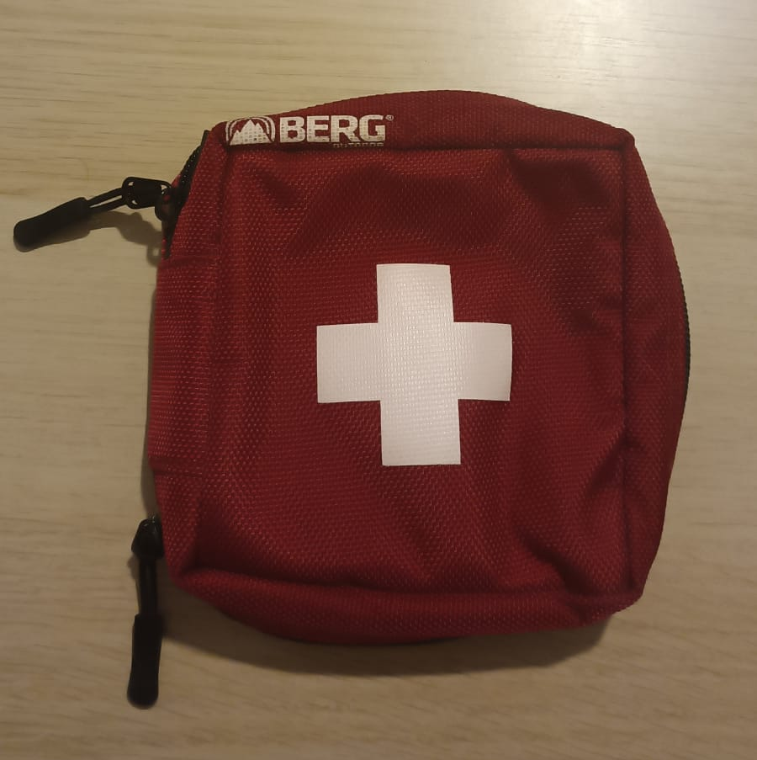
First Aid Box
What should it contain?

Slide 4
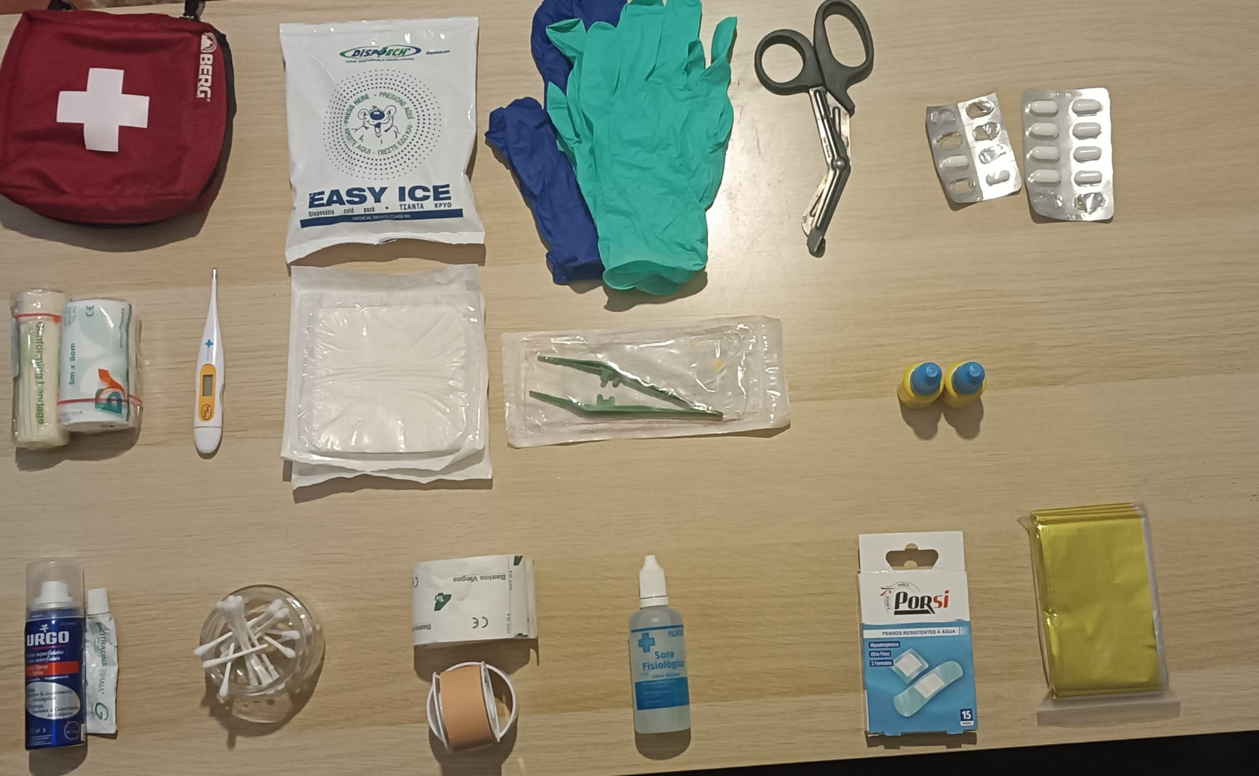

Slide 5
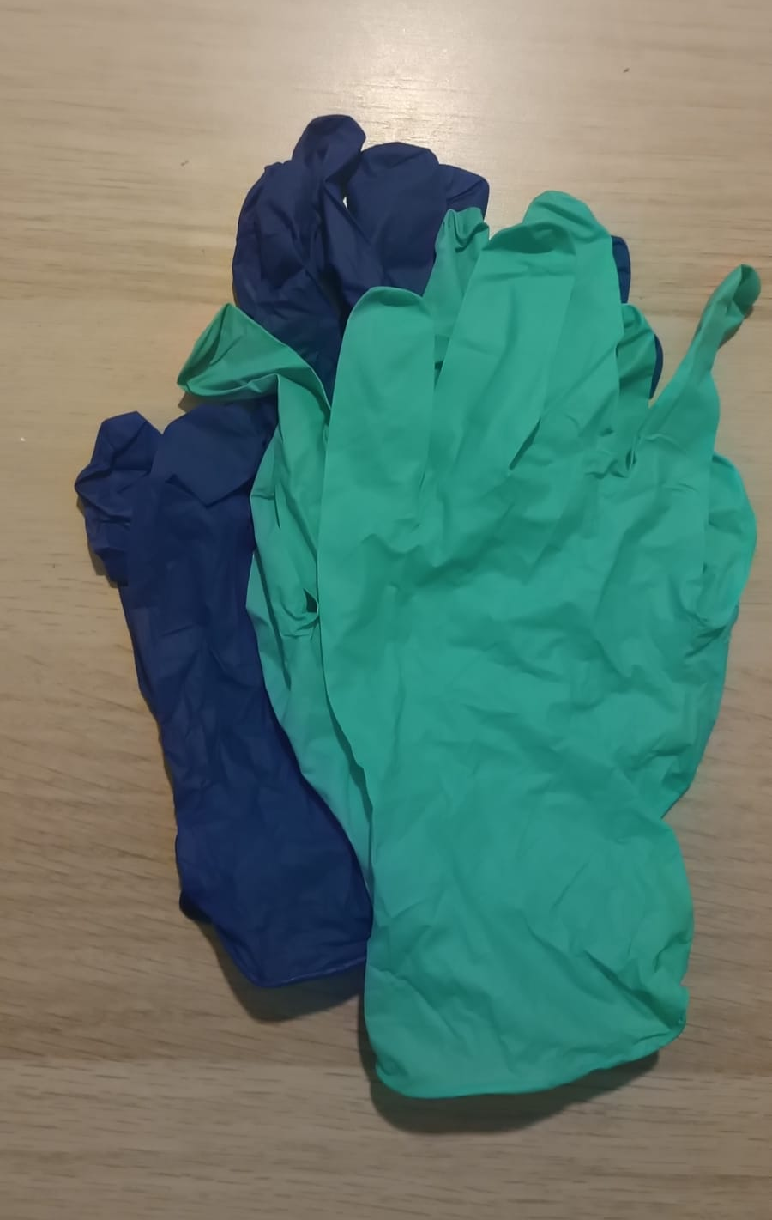
gloves

Slide 6
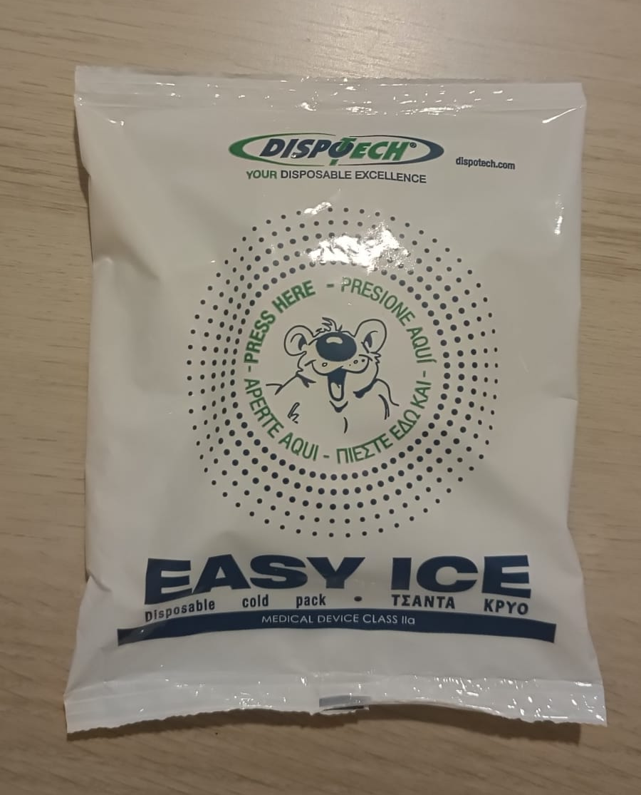
ice bag

Slide 7
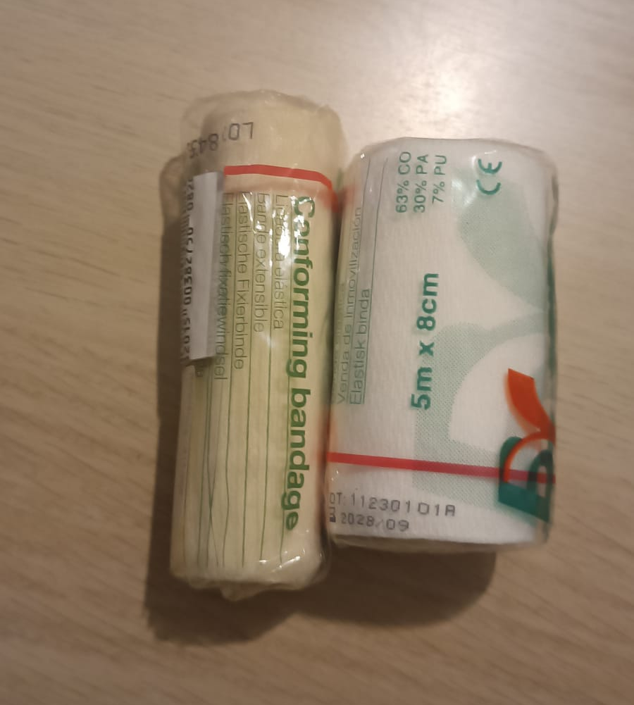
bandages

Slide 8
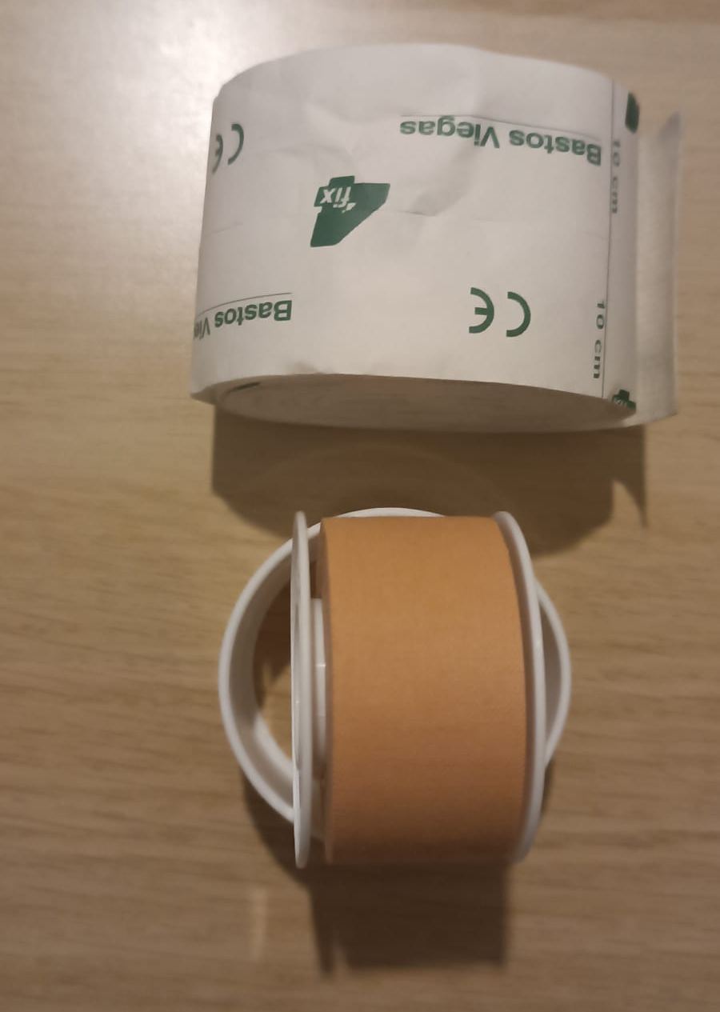
adhesive tape

Slide 9
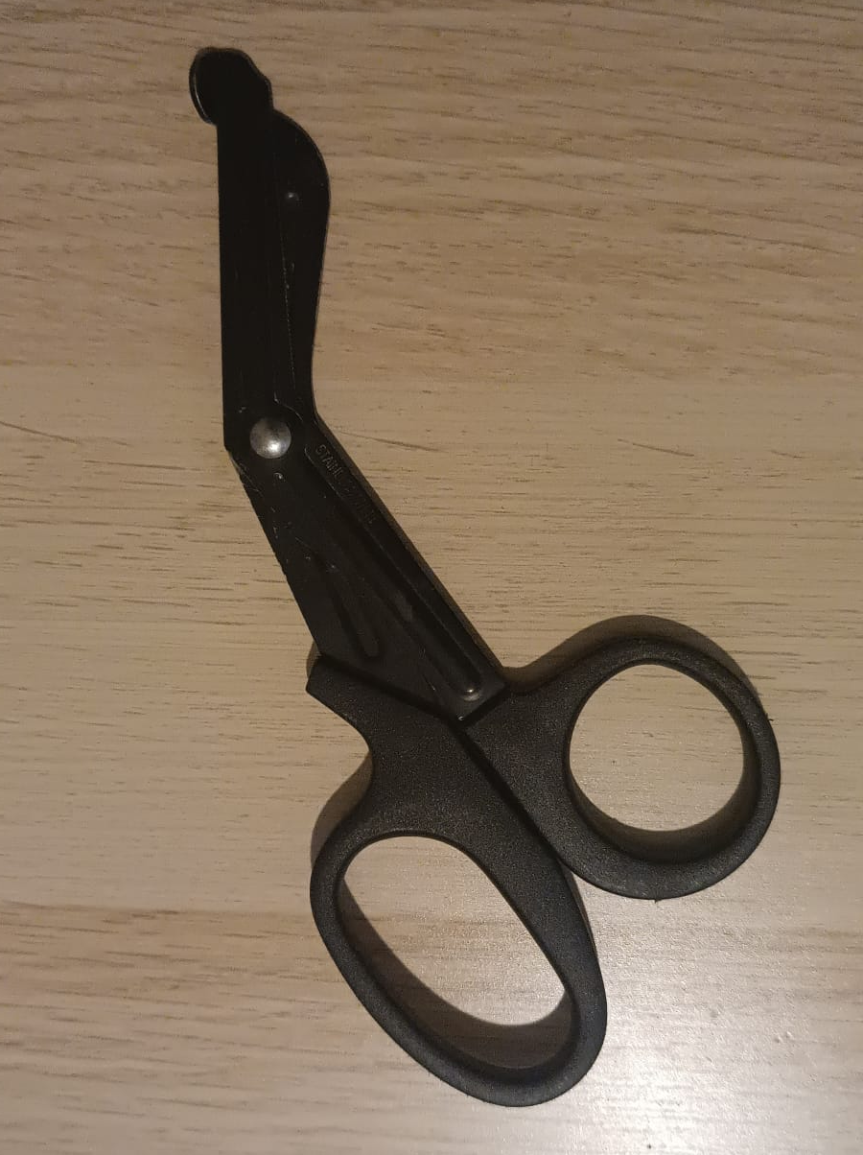
scissors

Slide 10
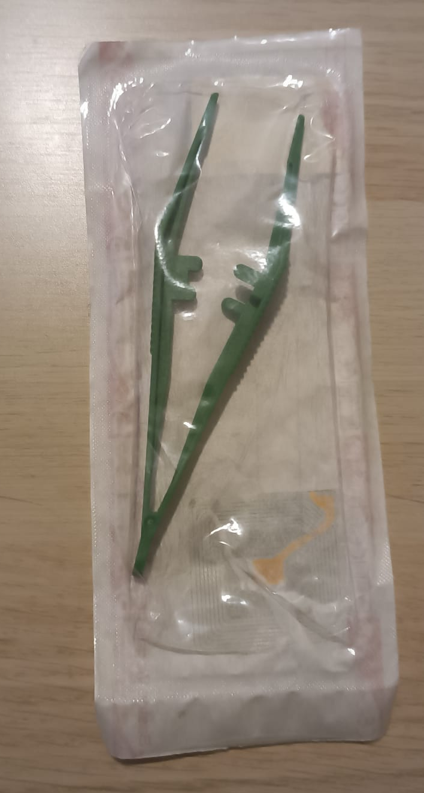
tweezers

Slide 11
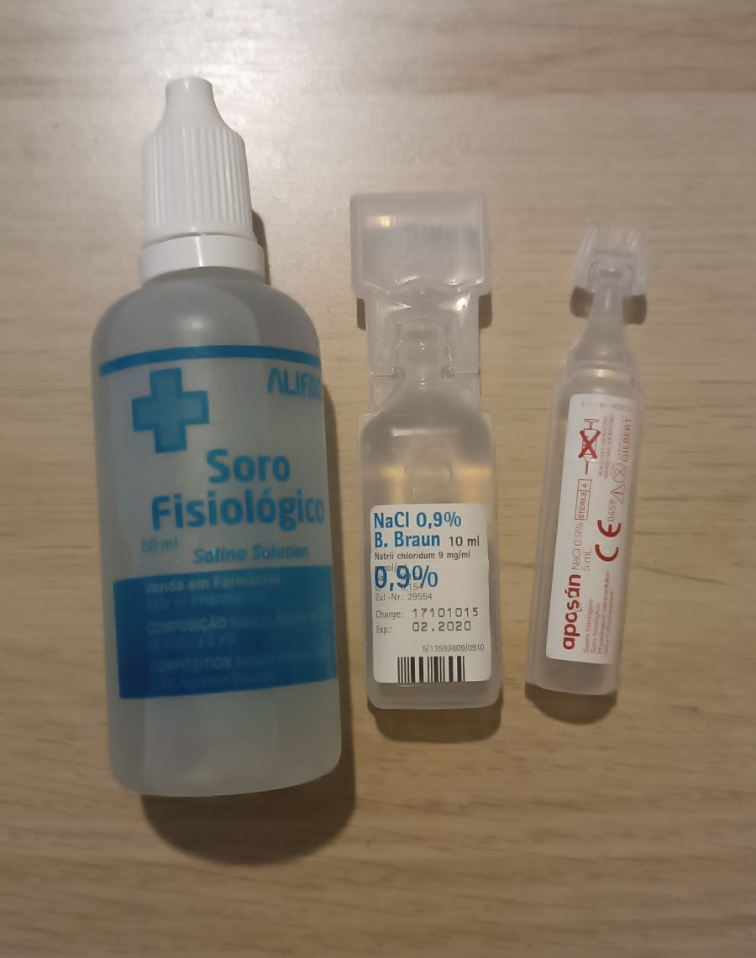
saline solution

Slide 12
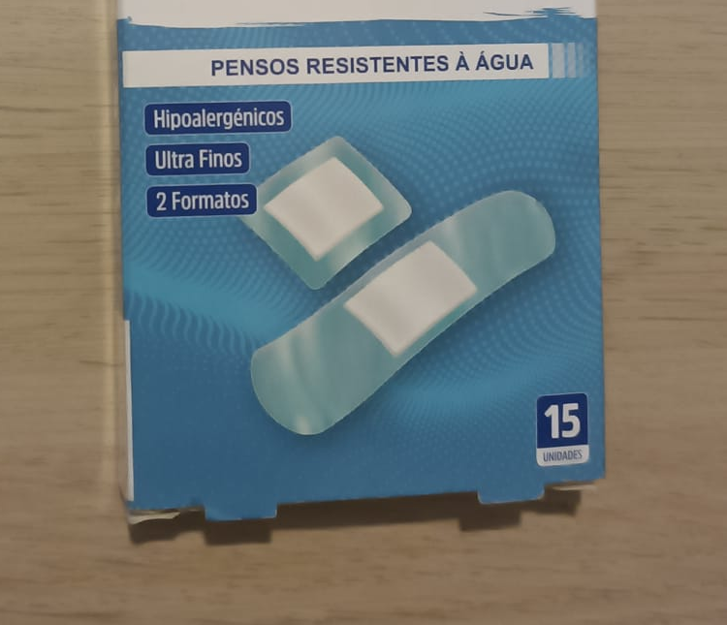
bandages

Slide 13
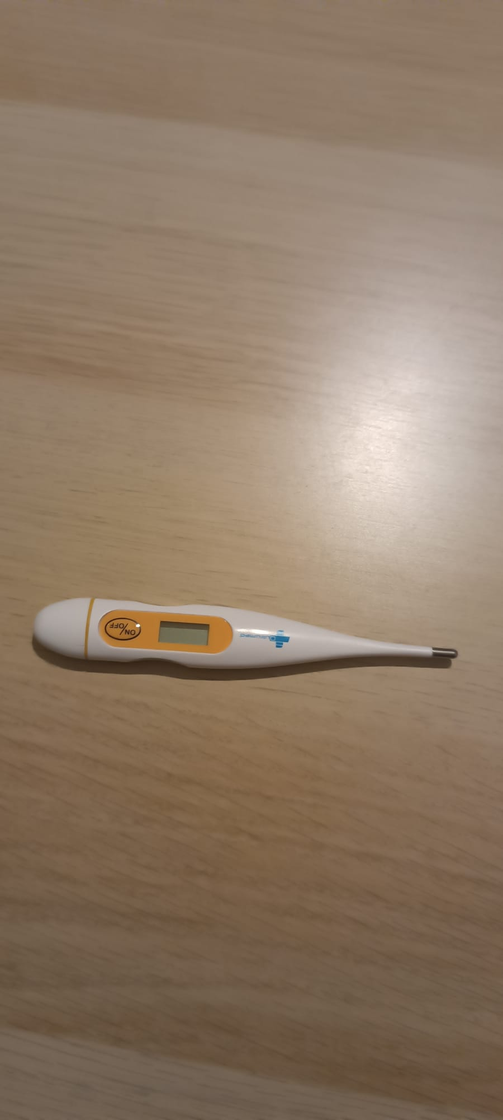
thermometre

Slide 14
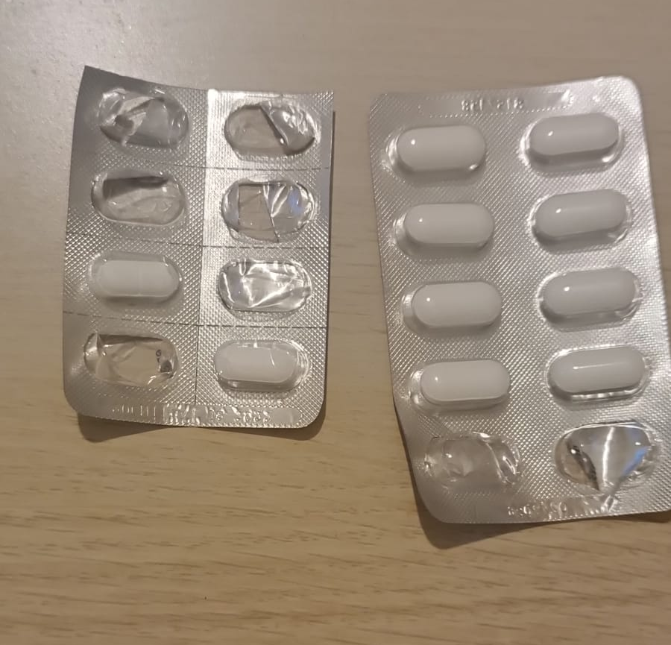
tablets
anti-inflammatory and painkillers

Slide 15
2022-1-BG01-KA220-SCH-000085065
Subject: Natural Science
Age of students: 8 – 9 years old
Topic: Nature
Resource Title: First Aid
Credits: AECE – Escola Básica da Zona Verde
All media are within the EU intellectual property law.
The European Commission’s support for this publication does not constitute an endorsement of the contents, which reflect the views only of the authors, and the Commission cannot be held responsible for any use which may be made of the information contained herein.

